Slide 1
Guidelines for Individualized Academic Curriculum and ITS Implementation for K-12 Students: a Resource Guide
ITS search tool
Search Criterion: -- Subject(s)/Domain -- -- Grade Range -- -- Tutor/Instruction Type --
Math
ELA
Science
History
English
Pre-K
Elementary
Middle
High
Core Curriculum
Complimentary
Catch-Up
 | School | Subject | Grade | Link | Add to
1 | Carnegie Learning | Math (Algebra) | Grade: 9 | https://www.carnegielearning.com/solutions/math
2 | School 2 | ELA | Grade: 7 | https://school2/this/link/will/not/work
3 | School 3 | ELA | Grade: 7 | https://school3/this/link/will/not/work
4 | IXL | Science (Chemistry) | Grade: 12 | https://www.ixl.com/science
5 | IXL | Social Studies | Grade: 2 | https://www.ixl.com/social-studies
6 | School 8 | Social Studies | Grade: 5 | https://school8/this/link/will/not/work
ITS Implementation Resource Page
< 1 2 3 4 >
CS6460: GPACII-K12 – Wireframe Prototype

Slide 2
CS6460: Educational Technology
Guidelines for Individualized Academic Curriculum and ITS Implementation for K-12 Students: a Resource Guide
Project Abstract
Intelligent Tutoring Systems (ITSs) and Individualized Education Plans (IEPs) have existed for decades in education. Researchers, through meta-analyses, have demonstrated the efficacy of ITS(s), irrespective of field of study (technical and non-technical subjects) in K-12 education (Ma et al, 2014). Modern ITS can evaluate and identifying a student’s emotional state and meta-cognitive skills, such as self-monitoring, self-explanation, etc (Conati, 2009). Since the 1970s, IEPs are, by law, implemented for students which are covered by IDEA (Individuals with Disabilities Education Act). An IEP is constructed annually by educators, administrators, and parents of special education students to define specific academic and functional goals per student.
Building on existing research and education practice, this site offers a resource for any individual constructing a curriculum for a K-12 student, looking to implement ITS(s) within a field of study. This site is built for parents / tutors / teachers and students to provide: (1) a background on IEP history and usage; (2) guidelines for planning a student’s curriculum with ITS(s) implemented; (3) a repository and search tool for commercially available ITS.
Site Overview
When building an individualized curriculum, use the guidelines as a reference.
Subpages included:
Guidelines
Background Information
Resources/Assessment
Research Log
Use the ITS Search page to find a solution.
Subpages included:
Guidelines
Background Information
Resources/Assessment
Research Log
CS6460: GPACII-K12 – Card Prototype
Home

Slide 3
CS6460: Educational Technology
Guidelines for Individualized Academic Curriculum and ITS Implementation for K-12 Students: a Resource Guide
Academic Planning
Background Information
Guidelines
Resources/Assessment
Research Log
ITS Search
Background Information
Search Tool
Full School List
Research Log
Why?
This resource is…
This resource is not…
Project Abstract
Intelligent Tutoring Systems (ITSs) and Individualized Education Plans (IEPs) have existed for decades in education. Researchers, through meta-analyses, have demonstrated the efficacy of ITS(s), irrespective of field of study (technical and non-technical subjects) in K-12 education (Ma et al, 2014). Modern ITS can evaluate and identifying a student’s emotional state and meta-cognitive skills, such as self-monitoring, self-explanation, etc (Conati, 2009). Since the 1970s, IEPs are, by law, implemented for students which are covered by IDEA (Individuals with Disabilities Education Act). An IEP is constructed annually by educators, administrators, and parents of special education students to define specific academic and functional goals per student.
Building on existing research and education practice, this site offers a resource for any individual constructing a curriculum for a K-12 student, looking to implement ITS(s) within a field of study. This site is built for parents / tutors / teachers and students to provide: (1) a background on IEP history and usage; (2) guidelines for planning a student’s curriculum with ITS(s) implemented; (3) a repository and search tool for commercially available ITS.
Site Overview
When building an individualized curriculum, use the guidelines as a reference.
Subpages included:
Guidelines
Background Information
Resources/Assessment
Research Log
Use the ITS Search page to find a solution.
Subpages included:
Guidelines
Background Information
Resources/Assessment
Research Log
CS6460: GPACII-K12 – Card Prototype
Home

Slide 4
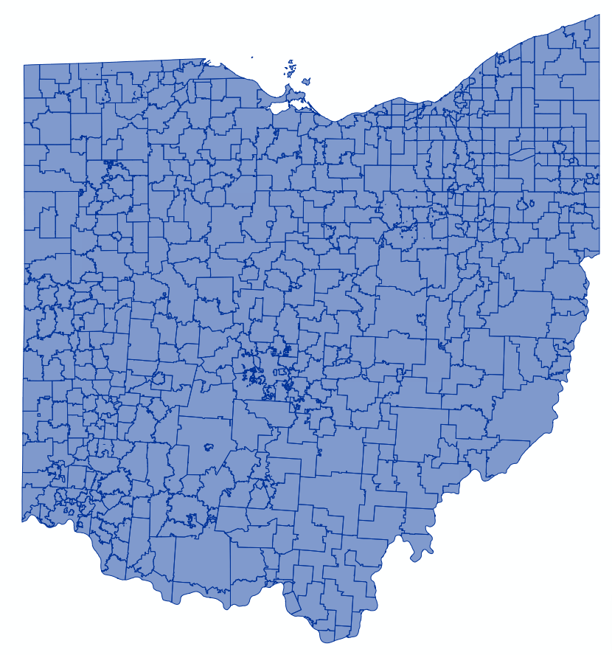
CSE 6242 Team #73: US School District Map Wireframe Prototype C
Comparison: by Time by State by County by City by District
Color by
Graduation Rate
Median SAT Scores
Median ACT Scores
College Matriculation Rate
--Select--
--Select--
New Mexico
Nevada
New York
Ohio
Oklahoma
Oregon
Pennsylvania
Rhode Island
South Carolina
New Mexico
Nevada
New York
Ohio
Oklahoma
Oregon
Pennsylvania
Rhode Island
South Carolina
--Data Set Select--
90-100
80-90
70-80
60-70
50-60
40-50
30-40
20-30
10-20
0-10
90-100
80-90
70-80
60-70
50-60
40-50
30-40
20-30
10-20
0-10
Time Range 1:
2010-2015
Time Range 2:
2015-2020
Time Interval: 10 Year 5 Year 2 Year
Time Interval: 10 Year 5 Year 2 Year

